Slide 1
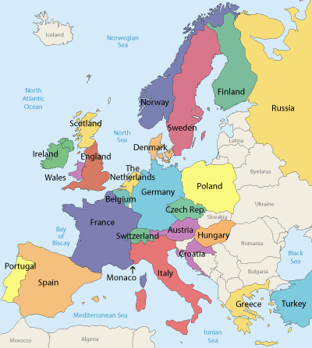
European History Overview
Learning Target: How did Europe’s culture and traditions affect the development of the United States?

Slide 2
Opening Activity
Define the following terms using your text book:
Monotheism
Salvation
Direct Democracy
Republic
Feudalism
Page 22

Slide 3
Religions
Judaism and Christianity Influence Europe
European beliefs and values were influenced by Judaism and Christianity, collectively referred to as the Judeo-Christian tradition.
Monotheism
Salvation
Moral Codes

Slide 4
Judaism
Around 1700 B.C., a system of beliefs called Judaism arose among the Israelites, a nomadic people of the Middle East.
Judaism was the first major world religion to teach monotheism.

Slide 6
Influence
Judaism and Christianity shaped European religious and moral thinking.
At the same time, ancient Greek and Roman ideas shaped European political traditions.
Greek and Roman ideas would later deeply influence the founders of the United States.

Slide 7
Greek Democracy
Athens
known as birthplace
Direct Democracy
Ordinary citizens took part in government
Women, slaves and foreigners could not participate

Slide 8
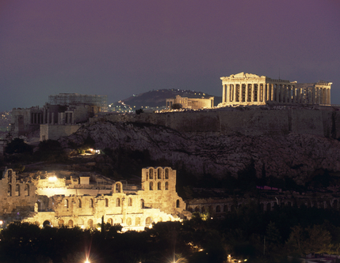
Ancient Ruins in Athens

Slide 9
The Roman Republic
Republic
When people choose others to represent their interests
Roman Law
Everyone equal under the law
Innocent until proven guilty
Republic collapses after civil wars
Octavian declares himself emperor for life

Slide 10
What are some of the ideas that the American system borrowed from the Roman Republic?
Everybody is equal under the law.
People accused of crimes are considered innocent until proven guilty.

Slide 11
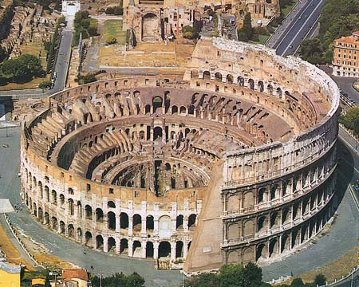

Slide 12
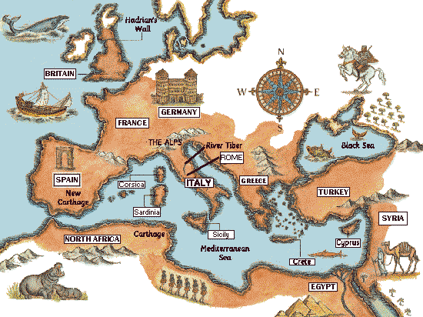

Slide 13
Rome’s Decline
Barbarian Invasions
Huns
Goths
Civil Wars
Empire becomes too large
Leads to the Dark Ages

Slide 14
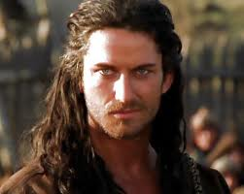
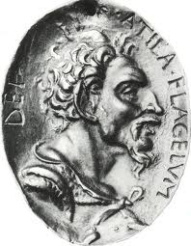
Attila the Hun

Slide 15
Closing Questions
With your neighbor……
Does the U.S. face any of the same problems Rome did in controlling such a large empire?
How did the Roman Empire help Christianity spread?
What kind of government do we have today?
Why did this form of government develop in the United States?

Slide 16
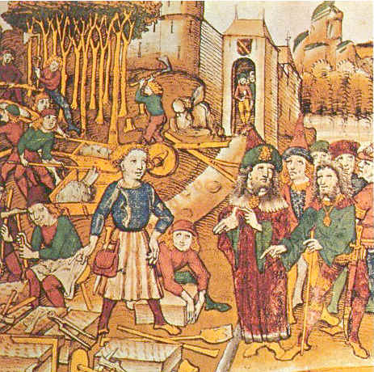
The Middle Ages

Slide 17
The Middle Ages
Rome Falls
Former territories form independent countries
France, Britain, German States, Spain
Feudalism develops
Rulers give land to lords for loyalty
Lords make up the army of the ruler

Slide 18
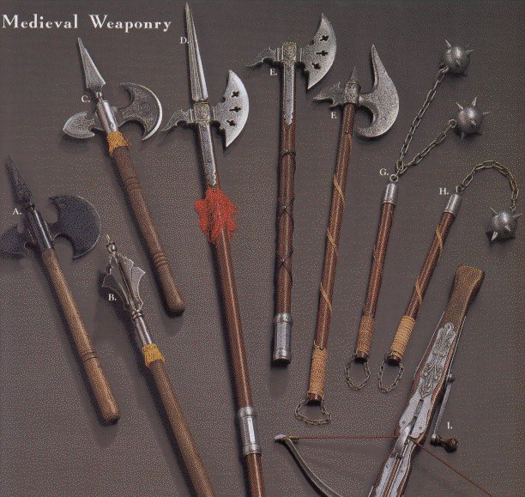

Slide 19
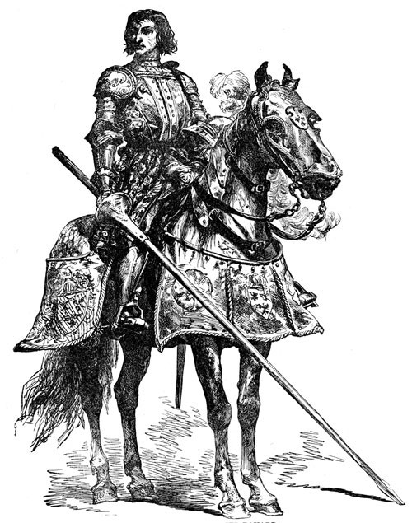

Slide 20
The Crusades
European Rulers fight for the Holy Land
Asked to by the catholic church
Mixed success
Eventually defeated
Contact with Asia
Bring back new knowledge, spices, ideas, technology

Slide 21
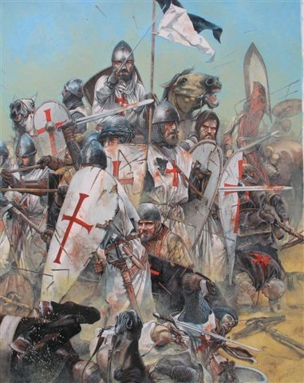

Slide 22
Although the Crusades ultimately failed, they had important long-term effects:
Europeans had closer contact with the more advanced Muslim civilization.
Europeans learned about advanced technology used for navigation.

Slide 23
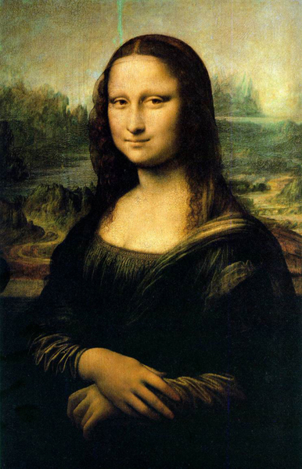
The Renaissance
Study classical Greek and Roman works
Science, invention and the arts flourish
Leonardo Da Vinci

Slide 24
The Renaissance
Time Period | The Renaissance, a rebirth of learning in Europe, began in the 1300s.
Philosophy and Art | European scholars and artists rediscovered classical Greek and Roman texts and art.
Science and Inventions | Johann Gutenberg’s printing press made more books available and boosted literacy rates.
Powerful New Nation-States | The new nations—Spain, Portugal, France, and England—shifted important trade routes from the Mediterranean to the Atlantic Ocean.

Slide 25
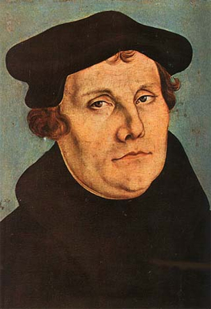
The Reformation
Martin Luther 1517
Calls for church reform
Church rejects his proposal
Luther protests
Therefore his followers become known as protestants

Slide 26
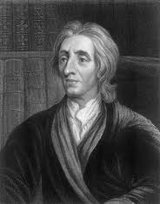
John Locke
Natural Rights – rights that belong to every human from birth
Life, liberty and property
Inalienable
Declaration of Independences says:
Life, liberty and the pursuit of ___________.
Why are they different???

Slide 27
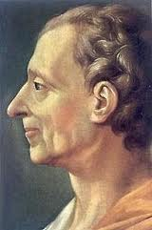
Baron de Montesquieu
Separation of powers – division of the government powers into separate branches
Protects rights of the people from stopping one person/group from gaining too much power

Slide 28
Discussion Questions
How did the Crusades affect Europe?
What ideas from Locke do we use today?
What ideas from Montesquieu do we use today?

